Slide 1
Lecture 2: Introduction to Classes and Objects
Advanced Programming(Java)

Slide 2
Classes contain data definitions
Classes describe the data held by each of its objects
Example:
  class Dog {
  String name;
  int age;
  ...rest of the class...
  }
Data usually goes first in a class
A class may describe any number of objects
  Examples: "Fido", 3; "Rover", 5; "Spot", 3;

Slide 3
Classes contain methods
A class may contain methods that describe the behavior of objects
Example:
  class Dog {
  ...
  void bark() {
  System.out.println("Woof!");
  }
  }
Methods usually go after the data
When we ask a particular Dog to bark, it says “Woof!”
Only Dog objects can bark; the class Dog cannot bark

Slide 4
Methods contain statements
A statement causes the object to do something
  (A better word would be “command”—but it isn’t)
Example:
  System.out.println("Woof!");
  This causes the particular Dog to “print” (actually, display on the screen) the characters Woof!

Slide 5
Classes always contain constructors
A constructor is a piece of code that “constructs,” or creates, a new object of that class
If you don’t write a constructor, Java defines one for you (behind the scenes)
You can write your own constructors
Example:
  class Dog {
  String name;
  int age;
  Dog(String n, int age) {
  name = n;
  this.age = age;
  }
  }
(This part is the constructor)

Slide 6
Diagram of program structure
Program
File
File
File
Class
Variables
Constructors
Variables
File
Statements
Methods
Variables
A program consists of one or more classes
Typically, each class is in a separate .java file
Statements

Slide 7
class Planet
{
public double radius;
public String name;
public static final long g = 10;
public void display()
{
System.out.println("Radius "+ radius);
System.out.println("Name " + name);
System.out.println("Long "+ g);
}
public void initialize()
{
radius = 10; //usage
name = "Dunya"; //usage
}
public static void main(String [] args)
{
Planet p = new Planet(); // creation
p. initialize(); //usage
p.display(); //usage
}
}

Slide 8
Bicycle Class
class Bicycle {
int cadence = 0;
int speed = 0;
int gear = 1;
void changeCadence(int newValue) {
cadence = newValue;
}
void changeGear(int newValue) {
gear = newValue;
}
void speedUp(int increment) {
speed = speed + increment;
}
void applyBrakes(int decrement) {
speed = speed - decrement;
}
void printStates() {
System.out.println("cadence:"+cadence+" speed:"+speed+" gear:"+gear);
}
}
Fields
Methods

Slide 9
Bicycle class description
You may have noticed that the Bicycle class does not contain a main method. That's because it's not a complete application; it's just the blueprint for bicycles that might be used in an application. The responsibility of creating and using new Bicycle objects belongs to some other class in your application.

Slide 10
BicycleDemo
class BicycleDemo {
public static void main(String[] args) {
// Create two different Bicycle objects
Bicycle bike1 = new Bicycle();
Bicycle bike2 = new Bicycle();
// Invoke methods on those objects
bike1.changeCadence(50);
bike1.speedUp(10);
bike1.changeGear(2);
bike1.printStates();
bike2.changeCadence(50);
bike2.speedUp(10);
bike2.changeGear(2);
bike2.changeCadence(40);
bike2.speedUp(10);
bike2.changeGear(3);
bike2.printStates();
}
}

Slide 11
Output
cadence:50 speed:10 gear:2
cadence:40 speed:20 gear:3

Slide 12
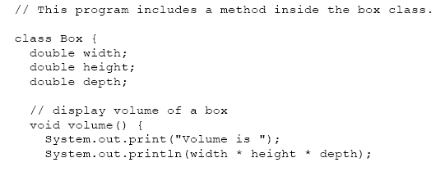
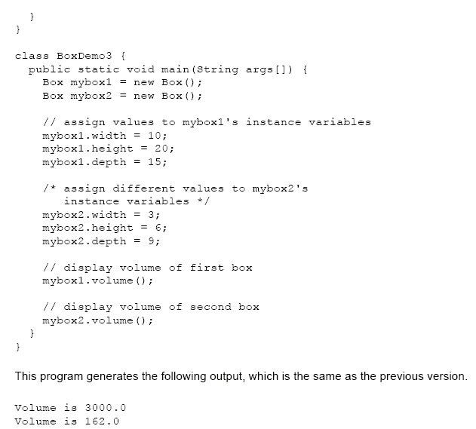
Box Class
Output

Slide 13
A complete “Dog” program
class Dog {
String name;
int age;
Dog(String n, int age) {
name = n;
this.age = age;
}
void bark() {
System.out.println("Woof!");
}
public static void main(String[ ] args) {
Dog fido = new Dog("Fido", 5);
fido.bark();
}
} // ends the class

Slide 14
Another “Dog” program
class Dog {
String name;
int age;
Dog(String n, int age) {
name = n;
this.age = age;
}
void bark() {
System.out.println("Woof!");
}
void wakeTheNeighbors( ) {
int i = 50;
while (i > 0) {
bark( );
i = i – 1;
}
}
public static void main(String[ ] args) {
Dog fido = new Dog("Fido", 5);
fido.wakeTheNeighbors();
}
} // ends the class

Slide 15
Methods may contain temporary data
Data described in a class exists in all objects of that class
  Example: Every Dog has its own name and age
A method may contain local temporary data that exists only until the method finishes
Example:
  void wakeTheNeighbors( ) {
  int i = 50; // i is a temporary variable
  while (i > 0) {
  bark( );
  i = i – 1;
  }
  }

Slide 16
Writing and running programs
When you write a program, you are writing classes and all the things that go into classes
Your program typically contains commands to create objects (that is, “calls” to constructors)
  Analogy: A class is like a cookie cutter, objects are like cookies.
When you run a program, it creates objects, and those objects interact with one another and do whatever they do to cause something to happen
  Analogy: Writing a program is like writing the rules to a game; running a program is like actually playing the game
You never know how well the rules are going to work until you try them out

Slide 17
Summary
A program consists of one or more classes
A class is a description of a kind of object
  In most cases, it is the objects that do the actual work
A class describes data, constructors, and methods
  An object’s data is information about that object
  An object’s methods describe how the object behaves
  A constructor is used to create objects of the class
Methods (and constructors) may contain temporary data and statements (commands)

Slide 18
Variables, Access Modifiers, Types

Slide 19
Access Modifiers public and private
private keyword
  Used for most instance variables
  private variables and methods are accessible only to methods of the class in which they are declared
  Declaring instance variables private is known as data hiding
public keyword
  Exposes variables or methods outside the Class.
  Declaring public methods is know as defining the class’ public interface.
Return type
  Indicates item returned by method
  Declared in method header

Slide 20
Access Specifiers: public, private, protected and default
We use these keywords to specify access levels for member variables, or for member functions (methods).
Public variables, are variables that are visible to all classes.
Private variables, are variables that are visible only to the class to which they belong.
Protected variables, are variables that are visible only to the class to which they belong, and any subclasses.
Deciding when to use private, protected, or public variables is sometimes tricky. You need to think whether or not an external object (or program), actually needs direct access to the information. If you do want other objects to access internal data, but wish to control it, you would make it either private or protected, but provide functions which can manipulate the data in a controlled way.

Slide 21
Access Specifiers: public, private, protected and default (contd..)
default
If you do not set access to specific level, then such a class, method, or field will be accessible from inside the same package to which the class, method, or field belongs, but not from outside this package.
This access-level is convenient if you are creating packages.

Slide 22
public class bank_balance {
public String owner;
public int balance;
public bank_balance( String name, int dollars )
{
owner = name;
if (dollars >= 0)
balance = dollars;
else
dollars =0;
}
}
Any object in the system can change the balance (setting it to zero, or even giving us a negative balance). This could cause the program to fall over, even though we wrote code in our constructor to prevent negative balances.

Slide 23
Variables
Local Variables declared in the body of method
  Called local variables
  Can only be used within that method
Variables declared in a class declaration
  Instance variables (Each object of the class has a separate instance of the variable)
  Class\static Variables

Slide 24
Difference between Class Variable and Instance Variable
These are the basic terms, in which , we need to be strong with out any confusions.
1. class members : members declared in a class. Both data members (variables declared in a class) as well as member functions (methods declared as in a class).
2. class variable : a data member which is declared with static modifier.
3. Instance variable : a data member in a class with out static modifier.

Slide 25
Difference between Class Variable and Instance Variable
The main difference between the class variable and Instance variable is, first time, when class is loaded in to memory, then only memory is allocated for all class variables.
That means, class variables not depends on the Objects of that classes. what ever number of objects are there, only one copy is created at the time of class loading.
The main advantage of this class variable is, suppose if we want to maintain a counter to count the no of object of type that class, in that case we use variable counter as the static variable.

Slide 26
Difference between Class Method Instance Method
Class method : a method with static modifier.
Instance method : a method with out static modifier.
For Both class method and Instance method , memory is allocated only once, that is loading the class.
But difference is, we can access the static method, directly with class name , with out using object of that class.
Where as Instance method can be access through only Objects or other non static method of same class (This concept is called nested method).

Slide 27
Restrictions with static methods
Of course, we have some restrictions with static methods:
1. static method can use only static variables.
2. static method can not access through the non static method and vice versa.

Slide 28
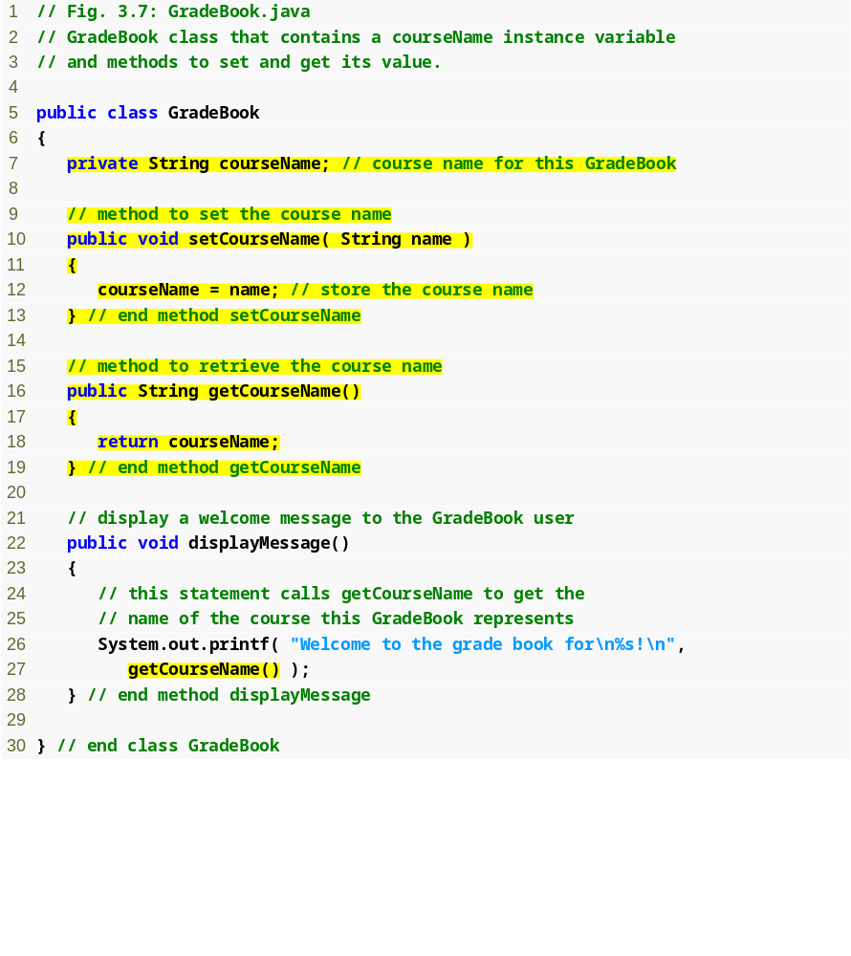
Outline
Instance variable courseName
GradeBook.java
set method for courseName
get method for courseName
Call get method

Slide 29
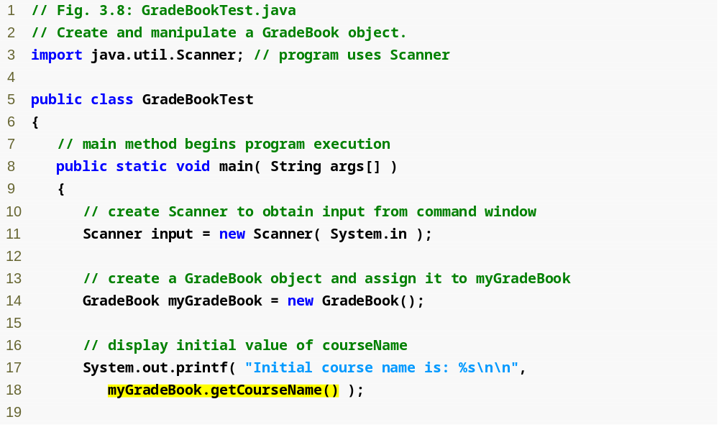
Outline
GradeBookTest.java
(1 of 2)
Call get method for courseName

Slide 30
THANK YOU

